Slide 1
D. Castro, J. Crowell, J. Garcia, A. Kalantarians, M. Lanza, A. Sobotka/Briner

Slide 2
Introduction Team Structure + Agenda
Abigail Sobotka/Briner Introduction Scope of Work
Juventino Garcia Stakeholder Analysis
Diego Castro Project Timeline
Pre-Engagement
James Crowell Active Engagement
Mike Lanza Post-Engagement
Budget Analysis
Abkar Kalantarians Lessons Learned
Conclusion

Slide 3
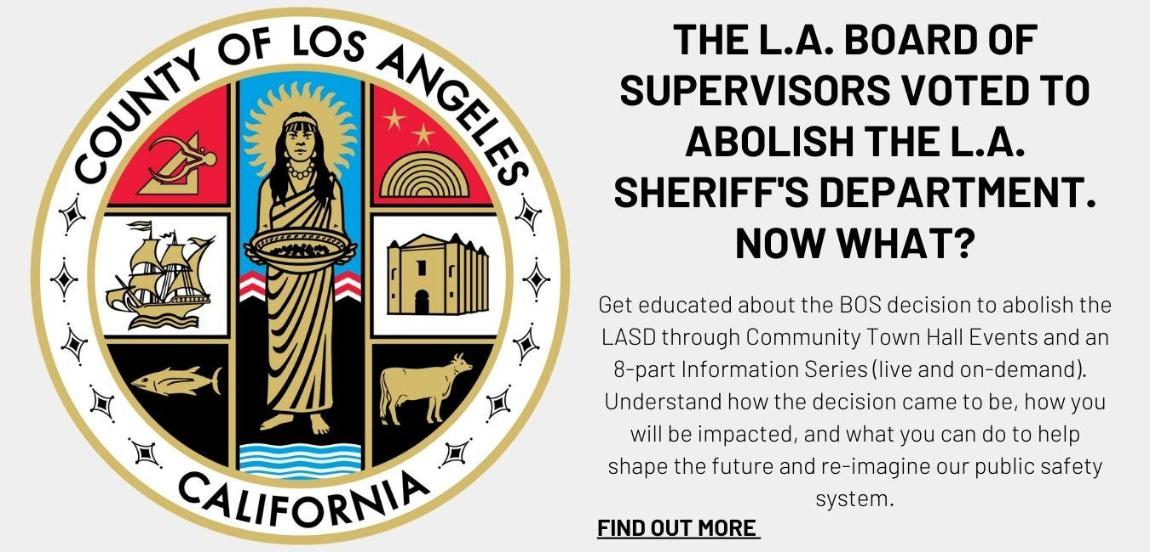
Scope of Work Introduction, context, expectations
Abolish LASD
Context, key issues
More info available: LA times, KnockLA
Purpose, promise, people
Acknowledge
Listen
Inform
Desired impact + outcomes
Level of engagement
Level of impact

Slide 4
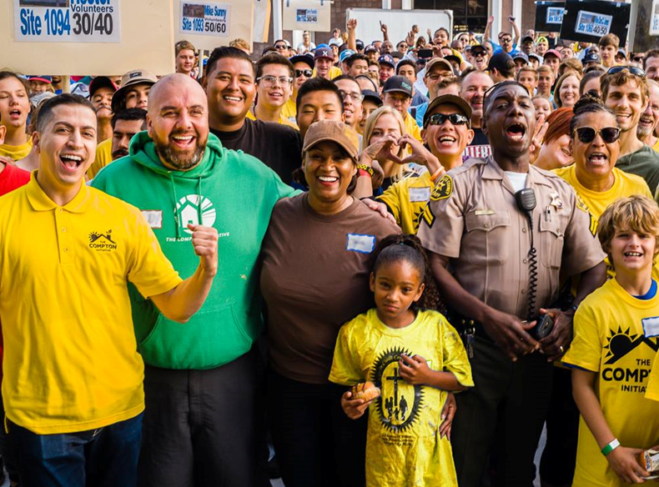
Stakeholder Analysis Key Stakeholders
Step 1: Analyze the composition of Compton
Step 2: Identify general stakeholder categories
Government/municipal agency
Public safety professionals
Community organizations
Advocacy groups
Private citizens
Influencers/other
Step 3: List Compton specific stakeholders
Step 4: Develop stakeholder engagement strategies

Slide 5
Project overview Timeline: 14 months
Organize, Hire & Create
Outreach, Meetings & Communicate
Update, Recap & Celebrate
PRE-ENGAGEMENT PHASE
8 MONTHS
ACTIVE ENGAGEMENT
4 MONTHS
POST
2 MONTHS
Volunteer Coordinator: recruit and design volunteer programs including door knocking, phone banking, guerilla marketing, and support-staffing at public events
Partner and Vendor Coordinator: partner with organizations and hire necessary vendors
Meeting Facilitator and Venue Procurement: coordinate all aspects of event logistics
Liaison with Digital Marketing Agency: instruct and oversee their efforts
Liaison with Communications Firm: instruct and oversee their efforts
Treasurer: oversee budget, pay vendor bills, organize all contact lists and manage all inflowing data and information
Notes:
Pure proposed inform plan will be broken down into three different steps. The first step is the pre-engagement stage lays the foundation and is crucial to ensuring the success of the overall project. As you can see from our timeline this stage has been allocated the greatest amount of time. This is mainly due to our want to organically establishment methods and partnership. After pre eng we will move to the engagement stage where we are directly and actively interacting with the public. Finally, the post-engagement stage closes the loop on the inform phase by allowing the core team to present their findings and provide the community one final chance to evaluate the process.
We have broken the pre-engagement phase into three parts the first part is
Part 1: Establish Team and Methods of Communication - This happens months before the engagement phase and is really where the project team starts to odd fifty key roles and begins working on establishing partnerships with local organizations and government agencies. Utilizing existing organizations allows us to learn more about the day to day life in compton and not to mention that these organizations have strong ties with the community.
During this part we will also be working with our digital marketing and communication liasons to establish a robust network of communication. This effectiveness of this network is crucial to the project and will be utilized in all phases. Most cities employed an average of three notification methods to advertise public hearings (Baker et al., 2005). And although this can be successful, considering how impactful the topic is, the core team has chosen to create a robust list of engagement methods to ensure that we notify as many people as possible. We will focus on building notification methods tailored to the City of Compton within this phase and as such will need to create material in english and spanish.

Slide 6
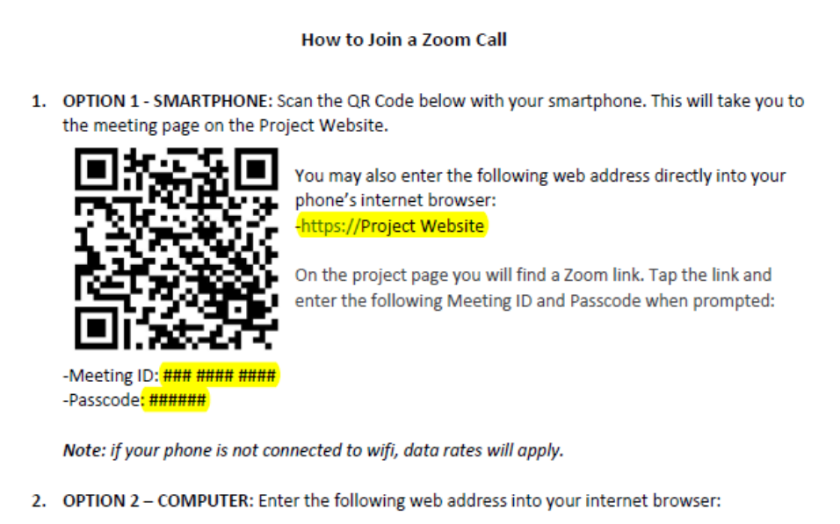
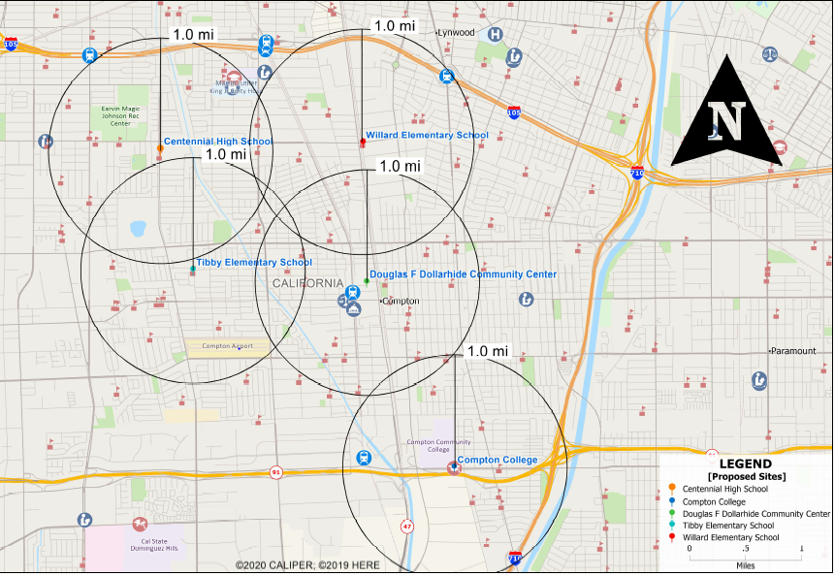
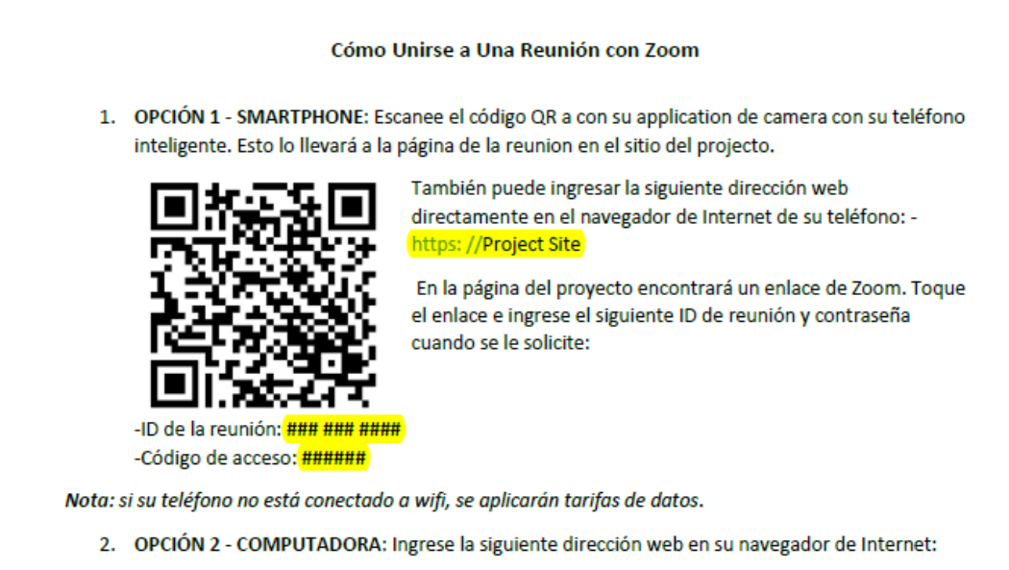
Pre-engagement phase Goals and Methods
A
B
C
E
D
Notes:
Part 2: Educational Materials - Now that we have identified the required methods of communication, our next step should be deciding what material needs to be produced to educate the public on any upcoming informational opportunities as well as creating pre hearing resources that teach people how to get involve. This material can help increase audience participation during the actual hearing. The team will break down the educational efforts into two categories: general education on how to get involved in the inform process, and the second category will provide information on the decision made by the BOS.
An example of pre hearing materials is the how to zoom template that we have created to show people how to join the virtual meetings As you can see the templates are E and S from the start. This is just a small snippet but the form in our plan includes computers smartphones and calling instruction
Part 3: Location is picking locations for these meetings. One of the first considerations in choosing meeting locations is the existing partnership between the BOS and City Council. The team was able to find a site in each of Compton's four districts and one centralized location near a major transit hub. Having meetings in each of Compton districts will allow the local City Council representative to attend and provide opening remarks during the initial kick-off meetings. We had to be conscious that people sometimes have to overcome high transaction costs to attend meetings and as such we chose places that can provide free child care and are easily accessible.

Slide 7
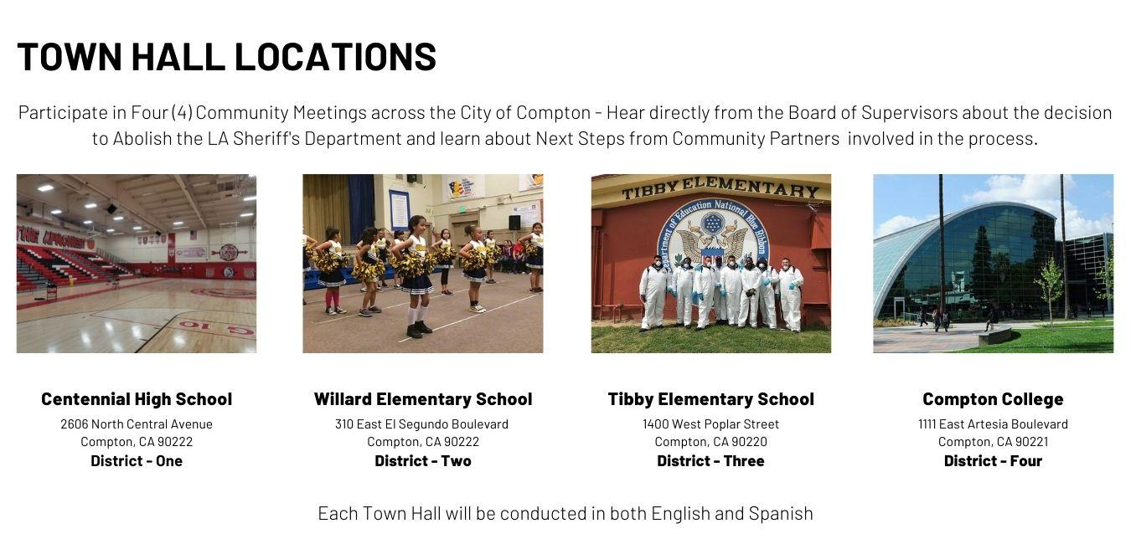
Pre-engagement phase Website example

Slide 8
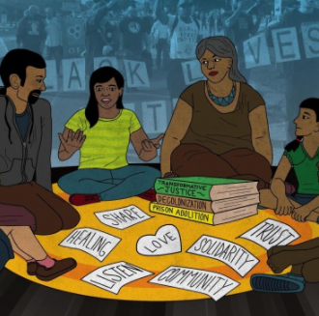
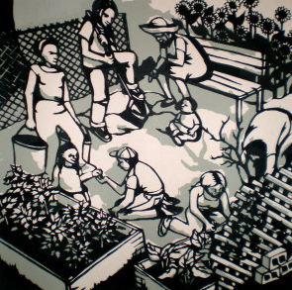
Active Engagement Phase Part 1: Inform the Public of the BOS Decision
We will hold 4 Town Halls in community locations that are:
Easily accessible
Representative of all 4 city districts
Have space to accommodate up to 300 people
Have capacity to provide food & childcare
Each Town Hall will consist of two 2-hour long meetings with the following agenda:
Introduction and overview of decision by Supervisor Mitchell
Overview of case study and consulting firm by District Representative
Outline of public engagement process by project lead
Introduction of educational partners and community presenters
Q & A session on process and decision for participants
Post Q & A opportunity for participants to recommend community members to be invited to next Town Hall
Notes:
The active engagement phase of our effort is where we really make a hard push to pull the community into the process
We want to do this so that we create a sense of ownership and establish a partnership that allows the process to become community driven and gives us, the consultant, the ability to lead the effort from behind.
This effort will include the use of several engagement techniques including but not limited to:
Town-halls
Seminars
Video production
and Round table discussions

Slide 9
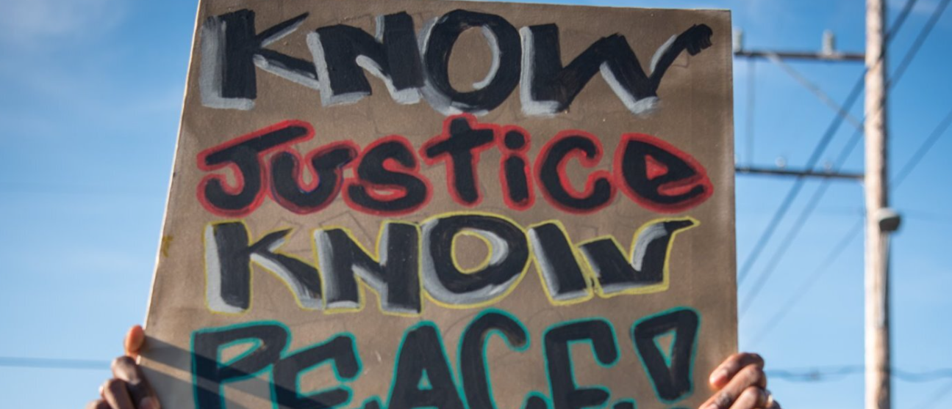
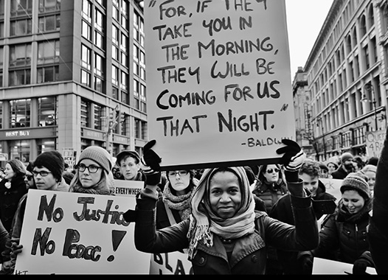
Active Engagement Phase Part 2: Educate the public regarding impact and significance
The content of the meetings will include:
The Beginnings of Policing (Critical Resistance LA)
Police for Hire (Education for Liberation Network)
Policing the Working Class (LA CAN)
The Evolution of Police Violence (Anti-Police Terror Project)
Police Unions and Protections (BLM LA - EPA)
Brutality and the Budget (CURB)
What Now? The Current State of Policing in America and LA (BLM LA)
What Next? Introduction to the Abolitionist Vision (Justice LA and LA ATI)
Notes:
Our overarching goal is to educate the public, giving them the ability and knowledge to engage and inform others with respect to the abolition movement essentially creating “informed” ambassadors
We expect this strategic “informing effort” to multiply our efforts as we move through the Active Engagement effort
We will endeavor to create an environment that fosters healthy and fruitful engagement through multiple public meetings

Slide 10
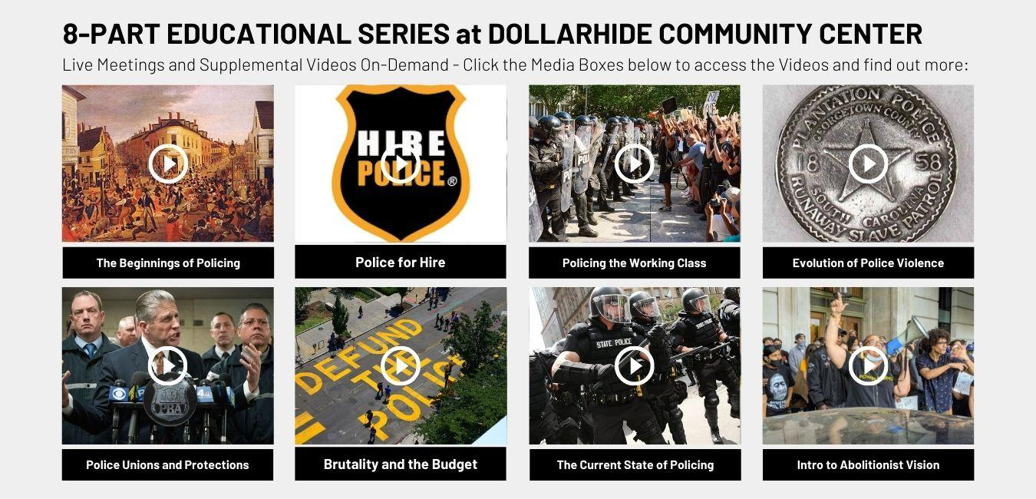
Active Engagement phase Website example
Notes:
And as we continue through the active engagement process, we will rely on the support of several different mechanisms of outreach such as a Website and other social media platforms
These platforms will be regularly updated to keep our material current
Used to provide a conduit to changing but relevant information
And to notify the public of events upcoming events
Flyers
Where information presented will be provided in English and Spanish
and utilize a ground-team to distribute information at a neighborhood level

Slide 11
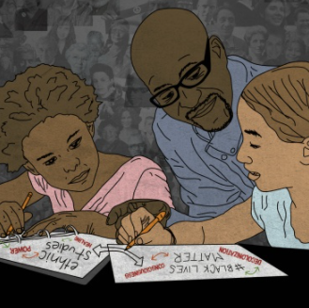
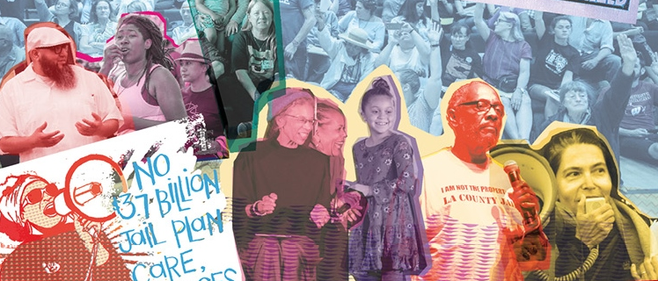
Active Engagement Phase Part 3: Prepare the Public to Participate
These trainings will cover:
How to submit public comment to the BOS and stay up-to-date on current events
How to contact your representatives and get involved in local decision making
Introduction to public speaking
Practicing public speaking
Notes:
An additional part of our Active Engagement effort will be to provide training that will empower the Compton community
We will help individuals learn how to participate in the engagement process both actively and passively
Helping the community to understand and influence the legislative process
And finally we will help individuals to learn and master public speaking

Slide 12
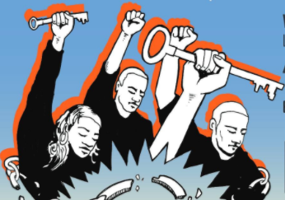
Active Engagement Phase Part 4: Community Resilience Celebration
The participation process will culminate in a Community Resilience Celebration meant to:
Thank the community for their participation
Acknowledge the liberation that comes through knowledge
Create a space for participants to share what they learned with loved ones and neighbors
Provide opportunities to create greater awareness and understanding
Offer food, feature local musicians and artists, allow community partners and social justice groups to share through informational booths
Notes:
Our final endeavor of The Active Engagement Phase will be to close the loop on outreach, training and preparation for community participation.
We will do this by bringing the community together to celebrate the success of its efforts throughout the Active Engagement process and thank the public for their participation while also communicating next steps for community involvement.
And the final step in Active Engagement will be to perform an evaluation of the Engagement process undertaken and release a cumulative report which will help the entire community to understand not only what took place but what was accomplished and how the process might be improved in the future.

Slide 13
Post-engagement phase Project conclusion
Step One: Thank the public and ask for feedback
Step Two: Inform that the work does not end here in the Abolish LASD Process
Step Three: Prepare and Release Cumulative Report
Notes:
In the post-engagement phase we close the loop and use, the various methods of communications that were used to outreach to thank the public for their participation and communicate next steps for involvement. The next steps are the evaluation period, the release of the cumulative report, and letting the public know that the work does not end here and that there will be a next phase in the abolish LASD process.
Goal of the evaluation period is to gain a deeper understanding of what worked and what could be improved as the BOS continues with this participatory process. We will give the community space to provide any feedback they have and comment on how satisfied they were with the information, meetings, and accommodations provided.
After receiving this evaluation we will incorporate it into a cumulative report that that will detaie what information was covered, partnerships established, and statistics on who participated and themes identified during the inform stage. The purpose of the report is to provide a comprehensive overview of the public engagement process that was used to inform the public on the abolish LASD process as well as prepare participants to continue to be involved in the participatory process. The cumulative report will be available on the project website and distributed by email; participants without internet access will have the opportunity to request a mailed copy.

Slide 14
Financial Summary Budget and Timeline
Pre-Engagement Phase: 8 months $590,000.00
Active Engagement Phase: 4 months $144,000.00
Post-Engagement Phase: 2 months $16,000.00
TOTAL BUDGET: $750,000.00
TOTAL TIMELINE: 14 MONTHS
PRE-ENGAGEMENT PHASE
8 MONTHS
ACTIVE ENGAGEMENT
4 MONTHS
POST
2 MONTHS

Slide 15
Project Summary Lessons Learned
Project Scope | Purpose & Promise
Sophistication through simplification
Importance of “Inform” for the success of other phases
Before how, comes what and most importantly why
Transparency is impossible without first having clarity
Geographical Scope
Compton demographics as a microcosm of the county
Use it as a pilot
If the plan works here, it can work anywhere
Use City of Compton government as a litmus test for the BOS

Slide 16
Project Summary Lessons Learned
Re-identification of Stakeholders
Change of focus changes Stakeholders
Shifting Stakeholders also requires strategy shift
Instead of a million things, do one thing really well
Leverage Team Dynamics
Forming human connections, one person at a time
Your team is a microcosm of the community you are reaching out to
Before reaching out to 90+k residents, make sure you have reached out to all team members

Slide 17
Questions? Comments? Concerns? We want to hear from you!

